Slide 1


Big Data Infrastructure
Session 11: Beyond MapReduce — Stream Processing
Jimmy Lin
University of Maryland
Monday, April 20, 2015
This work is licensed under a Creative Commons Attribution-Noncommercial-Share Alike 3.0 United States See http://creativecommons.org/licenses/by-nc-sa/3.0/us/ for details

Slide 2
Today’s Agenda
Basics of stream processing
Sampling and hashing
Architectures for stream processing
Twitter case study

Slide 3
What is a data stream?
Sequence of items:
Structured (e.g., tuples)
Ordered (explicitly or timestamped)
Arriving continuously at high volumes
Impossible to store entirely
Sometimes not process to even examine all items

Slide 4
What to do with data streams?
Network traffic monitoring
Datacenter telemetry monitoring
Sensor networks monitoring
Credit card fraud detection
Stock market analysis
Online mining of click streams
Monitoring social media streams

Slide 5
Common Architecture
queries
DSMS
data feeds
DBMS
DSMS
data streams
queries
Data stream management system (DSMS) at observation points
Voluminous streams-in, reduced streams-out
Database management system (DBMS)
Outputs of DSMS can be treated as data feeds to databases

Slide 6
DBMS vs. DSMS
DBMS
Model: persistent relations
Relation: tuple set/bag
Data update: modifications
Query: transient
Query answer: exact
Query evaluation: arbitrary
Query plan: fixed
DSMS
Model: (mostly) transient relations
Relation: tuple sequence
Data update: appends
Query: persistent
Query answer: approximate
Query evaluation: one pass
Query plan: adaptive

Slide 7
What makes it hard?
Intrinsic challenges:
Volume
Velocity
Limited storage
Strict latency requirements
Out-of-order delivery
System challenges:
Load balancing
Unreliable message delivery
Fault-tolerance
Consistency semantics (lossy, exactly once, at least once, etc.)

Slide 8
What exactly do you do?
“Standard” relational operations:
Select
Project
Transform (i.e., apply custom UDF)
Group by
Join
Aggregations
What else do you need to make this “work”?

Slide 9
Issues of Semantics
Group by… aggregate
When do you stop grouping and start aggregating?
Joining a stream and a static source
Simple lookup
Joining two streams
How long do you wait for the join key in the other stream?
Joining two streams, group by and aggregation
When do you stop joining?
What’s the solution?

Slide 10
Windows
Mechanism for extracting finite relations from an infinite stream
Windows restrict processing scope:
Windows based on ordering attributes (e.g., time)
Windows based on item (record) counts
Windows based on explicit markers (e.g., punctuations)
Variants (e.g., some semantic partitioning constraint)

Slide 11
Windows on Ordering Attributes
Assumes the existence of an attribute that defines the order of stream elements (e.g., time)
Let T be the window size in units of the ordering attribute
t₁
t₂
t₃
t₄
t₁'
t₂’
t₃’
t₄’
sliding window
t_{i}’ – t_{i} = T
t₁
t₂
t₃
tumbling window
t_{i+1} – t_{i} = T

Slide 12
Windows on Counts
Window of size N elements (sliding, tumbling) over the stream
Challenges:
Problematic with non-unique timestamps: non-deterministic output
Unpredictable window size (and storage requirements)
t₁
t₂
t₁'
t₃
t₂’
t₃’
t₄’

Slide 13
Windows from “Punctuations”
Application-inserted “end-of-processing”
Example: stream of actions… “end of user session”
Properties
Advantage: application-controlled semantics
Disadvantage: unpredictable window size (too large or too small)

Slide 14

Common Techniques
Source: Wikipedia (Pottery)

Slide 15
“Hello World” Stream Processing
Problem:
Count the frequency of items in the stream
Why?
Take some action when frequency exceeds a threshold
Data mining: raw counts → occurring counts → association rules

Slide 16
The Raw Stream…

Slide 17
Divide Into Windows…

Slide 18
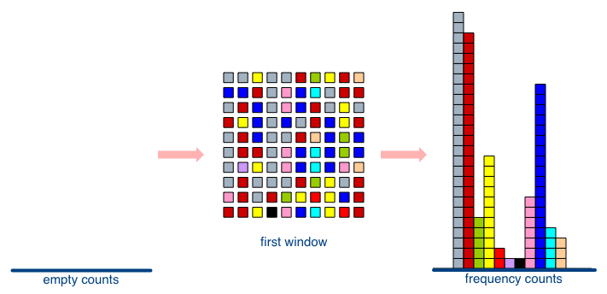
First Window

Slide 19
Second Window

Slide 20
Window Counting
What’s the issue?
What’s the solution?
Lessons learned?
Solutions are approximate (or lossy)

Slide 21
General Strategies
Sampling
Hashing

Slide 22
Three Common Tasks
Cardinality estimation
What’s the cardinality of set S?
How many unique visitors to this page?
Set membership
Is x a member of set S?
Has this user seen this ad before?
Frequency estimation
How many times have we observed x?
How many queries has this user issued?
HashSet
HLL counter
HashSet
Bloom Filter
HashMap
CMS

Slide 23
HyperLogLog Counter
Task: cardinality estimation of set
size() → number of unique elements in the set
Observation: let’s hash each item and examine the hash code
On expectation, 1/2 of the hash codes will start with 1
On expectation, 1/4 of the hash codes will start with 01
On expectation, 1/8 of the hash codes will start with 001
On expectation, 1/16 of the hash codes will start with 0001
…
How do we take advantage of this observation?

Slide 24
Bloom Filters
Task: keep track of set membership
put(x) → insert x into the set
contains(x) → yes if x is a member of the set
Components
m-bit bit vector
k hash functions: h₁ … h_{k}
0
0
0
0
0
0
0
0
0
0
0
0

Slide 25
Bloom Filters: put
put
X
h₁(x) = 2
h₂(x) = 5
h₃(x) = 11
0
0
0
0
0
0
0
0
0
0
0
0

Slide 26
Bloom Filters: put
put
X
0
1
0
0
1
0
0
0
0
0
1
0

Slide 27
Bloom Filters: contains
contains
X
h₁(x) = 2
h₂(x) = 5
h₃(x) = 11
0
1
0
0
1
0
0
0
0
0
1
0

Slide 28
Bloom Filters: contains
contains
X
h₁(x) = 2
h₂(x) = 5
h₃(x) = 11
A[h₁(x)]
A[h₂(x)]
AND = YES
A[h₃(x)]
0
1
0
0
1
0
0
0
0
0
1
0

Slide 29
Bloom Filters: contains
contains
Y
h₁(x) = 2
h₂(x) = 6
h₃(x) = 9
0
1
0
0
1
0
0
0
0
0
1
0

Slide 30
Bloom Filters: contains
contains
Y
h₁(x) = 2
h₂(x) = 6
h₃(x) = 9
A[h₁(x)]
A[h₂(x)]
AND = NO
A[h₃(x)]
0
1
0
0
1
0
0
0
0
0
1
0
What’s going on here?

Slide 31
Bloom Filters
Error properties: contains(x)
False positives possible
No false negatives
Usage:
Constraints: capacity, error probability
Tunable parameters: size of bit vector m, number of hash functions k

Slide 32
Count-Min Sketches
Task: frequency estimation
put(x) → increment count of x by one
get(x) → returns the frequency of x
Components
k hash functions: h₁ … h_{k}
m by k array of counters
m
0
0
0
0
0
0
0
0
0
0
0
0
0
0
0
0
0
0
0
0
0
0
0
0
k
0
0
0
0
0
0
0
0
0
0
0
0
0
0
0
0
0
0
0
0
0
0
0
0

Slide 33
Count-Min Sketches: put
put
X
h₁(x) = 2
h₂(x) = 5
h₃(x) = 11
h₄(x) = 4
0
0
0
0
0
0
0
0
0
0
0
0
0
0
0
0
0
0
0
0
0
0
0
0
0
0
0
0
0
0
0
0
0
0
0
0
0
0
0
0
0
0
0
0
0
0
0
0

Slide 34
Count-Min Sketches: put
put
X
0
1
0
0
0
0
0
0
0
0
0
0
0
0
0
0
1
0
0
0
0
0
0
0
0
0
0
0
0
0
0
0
0
0
1
0
0
0
0
1
0
0
0
0
0
0
0
0

Slide 35
Count-Min Sketches: put
put
X
h₁(x) = 2
h₂(x) = 5
h₃(x) = 11
h₄(x) = 4
0
1
0
0
0
0
0
0
0
0
0
0
0
0
0
0
1
0
0
0
0
0
0
0
0
0
0
0
0
0
0
0
0
0
1
0
0
0
0
1
0
0
0
0
0
0
0
0

Slide 36
Count-Min Sketches: put
put
X
0
2
0
0
0
0
0
0
0
0
0
0
0
0
0
0
2
0
0
0
0
0
0
0
0
0
0
0
0
0
0
0
0
0
2
0
0
0
0
2
0
0
0
0
0
0
0
0

Slide 37
Count-Min Sketches: put
put
Y
h₁(x) = 6
h₂(x) = 5
h₃(x) = 12
h₄(x) = 2
0
2
0
0
0
0
0
0
0
0
0
0
0
0
0
0
2
0
0
0
0
0
0
0
0
0
0
0
0
0
0
0
0
0
2
0
0
0
0
2
0
0
0
0
0
0
0
0

Slide 38
Count-Min Sketches: put
put
Y
0
2
0
0
0
1
0
0
0
0
0
0
0
0
0
0
3
0
0
0
0
0
0
0
0
0
0
0
0
0
0
0
0
0
2
1
0
1
0
2
0
0
0
0
0
0
0
0

Slide 39
Count-Min Sketches: get
get
X
h₁(x) = 2
h₂(x) = 5
h₃(x) = 11
h₄(x) = 4
0
2
0
0
0
1
0
0
0
0
0
0
0
0
0
0
3
0
0
0
0
0
0
0
0
0
0
0
0
0
0
0
0
0
2
1
0
1
0
2
0
0
0
0
0
0
0
0

Slide 40
Count-Min Sketches: get
get
X
h₁(x) = 2
h₂(x) = 5
h₃(x) = 11
h₄(x) = 4
A[h₁(x)]
A[h₂(x)]
MIN = 2
A[h₃(x)]
A[h₄(x)]
0
2
0
0
0
1
0
0
0
0
0
0
0
0
0
0
3
0
0
0
0
0
0
0
0
0
0
0
0
0
0
0
0
0
2
1
0
1
0
2
0
0
0
0
0
0
0
0

Slide 41
Count-Min Sketches: get
get
Y
h₁(x) = 6
h₂(x) = 5
h₃(x) = 12
h₄(x) = 2
0
2
0
0
0
1
0
0
0
0
0
0
0
0
0
0
3
0
0
0
0
0
0
0
0
0
0
0
0
0
0
0
0
0
2
1
0
1
0
2
0
0
0
0
0
0
0
0

Slide 42
Count-Min Sketches: get
get
Y
h₁(x) = 6
h₂(x) = 5
h₃(x) = 12
h₄(x) = 2
A[h₁(x)]
A[h₂(x)]
MIN = 1
A[h₃(x)]
A[h₄(x)]
0
2
0
0
0
1
0
0
0
0
0
0
0
0
0
0
3
0
0
0
0
0
0
0
0
0
0
0
0
0
0
0
0
0
2
1
0
1
0
2
0
0
0
0
0
0
0
0

Slide 43
Count-Min Sketches
Error properties:
Reasonable estimation of heavy-hitters
Frequent over-estimation of tail
Usage:
Constraints: number of distinct events, distribution of events, error bounds
Tunable parameters: number of counters m, number of hash functions k, size of counters

Slide 44
Three Common Tasks
Cardinality estimation
What’s the cardinality of set S?
How many unique visitors to this page?
Set membership
Is x a member of set S?
Has this user seen this ad before?
Frequency estimation
How many times have we observed x?
How many queries has this user issued?
HashSet
HLL counter
HashSet
Bloom Filter
HashMap
CMS

Slide 45
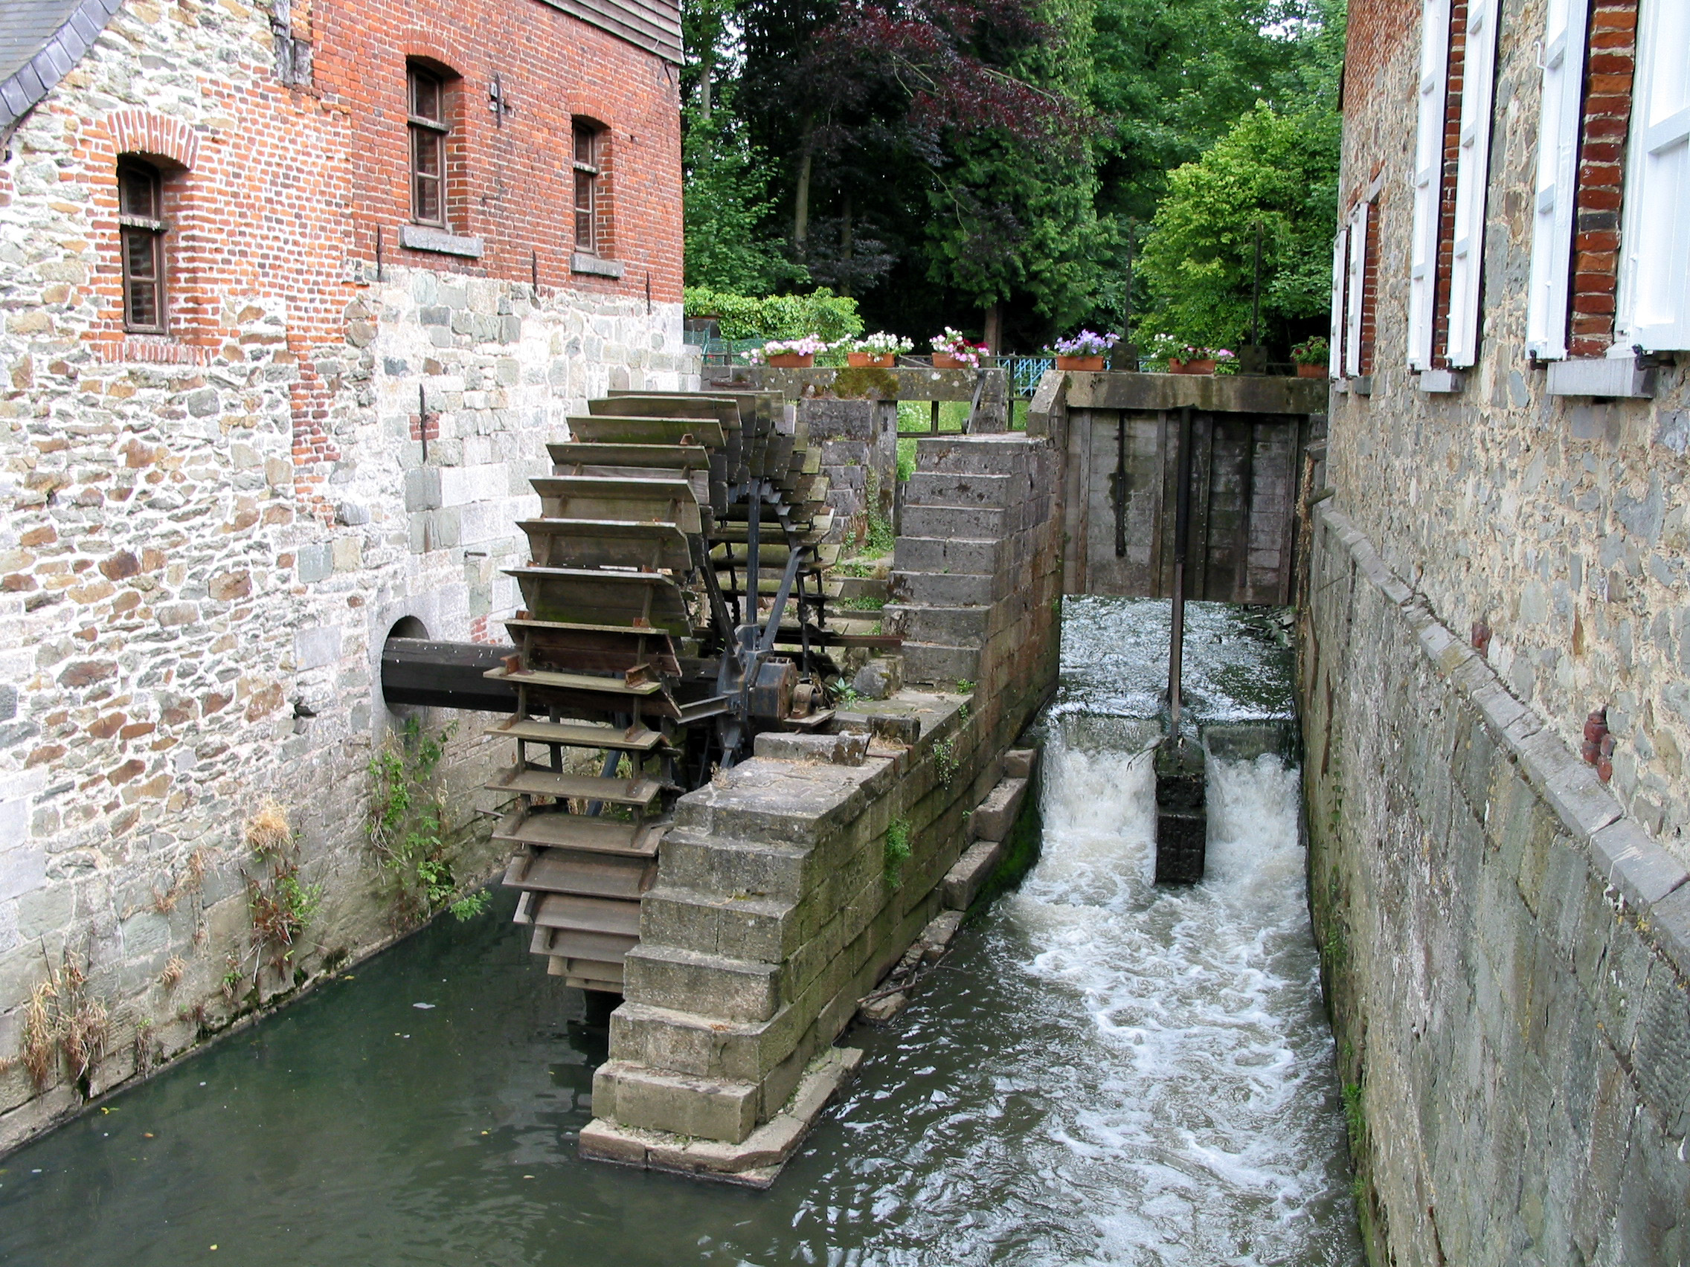
Stream Processing Architectures
Source: Wikipedia (River)

Slide 46
What we won’t cover…
Highly-specialized custom solutions

Slide 47

Questions?
Source: Wikipedia (Japanese rock garden)

